Slide 1
Passing the Objective Assessment
How to Prepare for the LPI Linux Essentials Certification Exam
C851 Cohort Session for Sunday, August 1, 2021
Dr. John S. Galliano | C851 Course Instructor

Slide 2
Agenda
Welcome
5 Domains
Exam Specifics
Demos/Hands-on
Sample Exam Questions
Wrap-Up

Slide 3

5 Exam Domains
The Linux Community and a Career in Open Source
Finding Your Way on a Linux System
The Power of the Command Line
The Linux Operating System
Security and File Permissions
Notes:
• Understanding the Linux industry and the open source movements
• Understanding the major components of a Linux distribution
• Gaining the technical proficiency to work on the Linux command line
• Gaining a basic understanding of security and administration in Linux
• Gaining a basic understanding of how to work with users, groups, and permissions

Slide 4

About the Exam
No prerequisites
Closed book
Up to 60 minutes
40 multiple-choice (with some multi-select and fill-in-the-blank items) questions
Minimum pass score 500 points (200-800 scale)
Partial credit:
Partially correct responses not accepted
For fill-in-the-blank questions LPI often accepts multiple correct versions of an answer (e.g., with/without leading path in a case where the answer is a command)
Lifetime certification

Slide 5
Compression Algorithms
Algorithm | Uncompress with | Extension
gzip | gunzip | .gz
bzip2 | bunzip2 | .bz2
xz | unxz | .xz

Slide 6
Archiving
Tape archiver (tar)
Archive
Multiple files collected into an archive
File extension: .tar
Tarball
Compressed archive
File extension: .tar.gz or .tgz
Linux compression utilities:
gzip
bzip2
xz

Slide 7
Archiving
Using zip
Provides “tarball-style” files for external use
Commonly known as a “zip” archive
Examples:
zip newzip.zip afile.txt figure.tif
unzip newzip.zip

Slide 8
tar Options
Option | POSIX Long Form | Action or Result
v | --verbose | Lists all files (use with –list for file sizes, ownership, and timestamps
W | --verify | Verifies archive after writing
(none) | --exclude file | Excludes file from archive
z | --gzip or --ungzip | Processes archive through gzip
j | --bzip2 | Processes archive through bzip2
J | --xz | Processes archive through xz

Slide 9
tar Options
Option | POSIX Long Form | Action or Result
c | --create | Create an archive
x | --extract or --get | Extract files from an archive
A | --concatenate | Append tar files to an archive
r | --append | Append non-tar files to an archive
u | --update | Append newer files to an archive
d | --diff or --compare | Compare an archive to files on disk
t | --list | List an archive’s contents

Slide 10
zip Options
Options | POSIX Long Form | Action or Result
-0 to -9 | N/A | Sets compression level
-d | --delete | Delete specified files from archive
-e | --encrypt | Encrypts archive with a password
-f | --freshen | Updates files in archive if changed since original archive created
-F or -FF | --fix or --fixfix | Repairs damaged archive
-FS | --filesync | Updates files in archive if changed since original archive created and deletes files from archive if deleted on filesystem

Slide 11
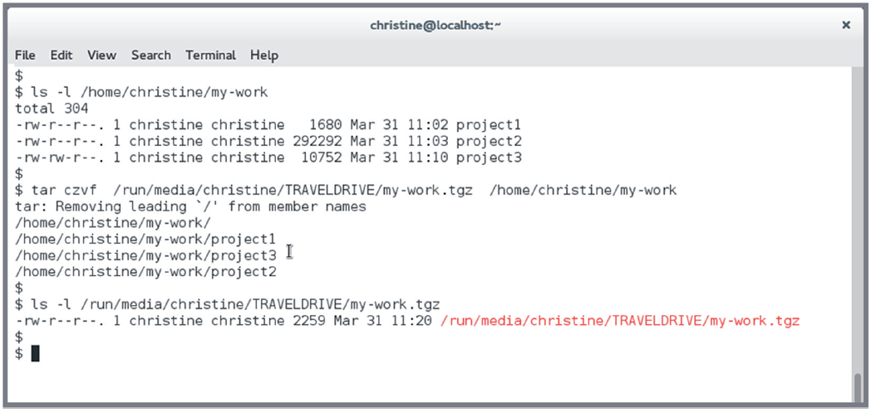
Example

Slide 12

Let’s Do Some Demos!
If you want to follow along, fire up your VM
Notes:
• Understanding the Linux industry and the open source movements
• Understanding the major components of a Linux distribution
• Gaining the technical proficiency to work on the Linux command line
• Gaining a basic understanding of security and administration in Linux
• Gaining a basic understanding of how to work with users, groups, and permissions

Slide 13
What Questions Do you Have for Me?

Slide 14
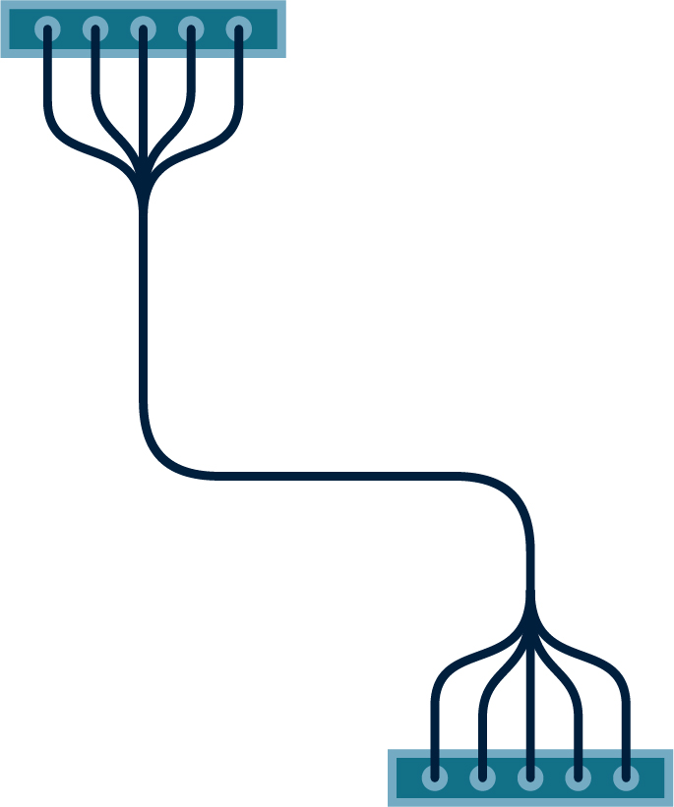































Icon Library - Page 1

Slide 15




























































Icon Library - Page 2

